Slide 1
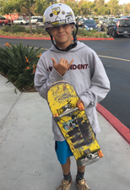
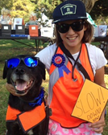
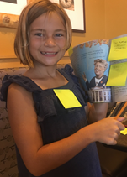
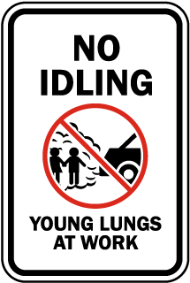
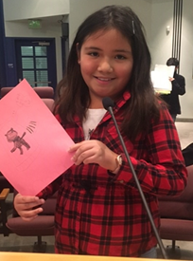
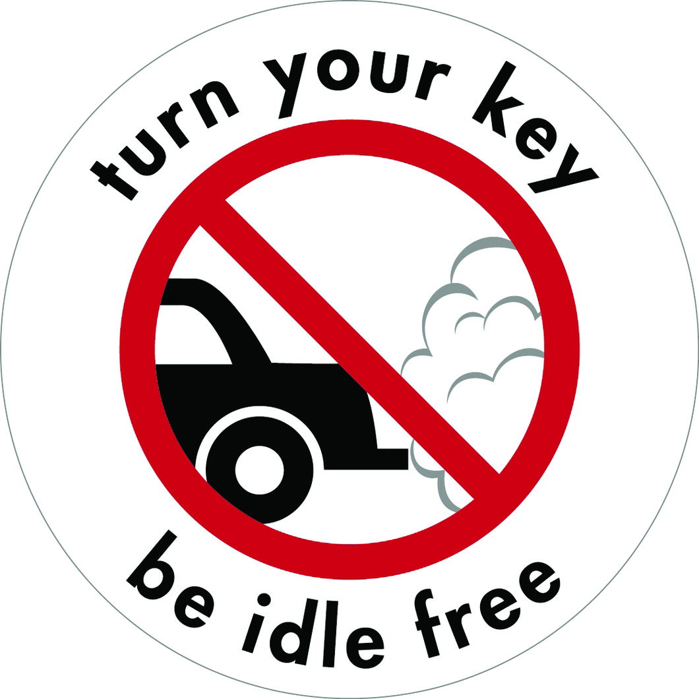
2.2 Billion Reasons To Stop Idling
Take the pledge.
Turn off your car when parked.

Slide 2
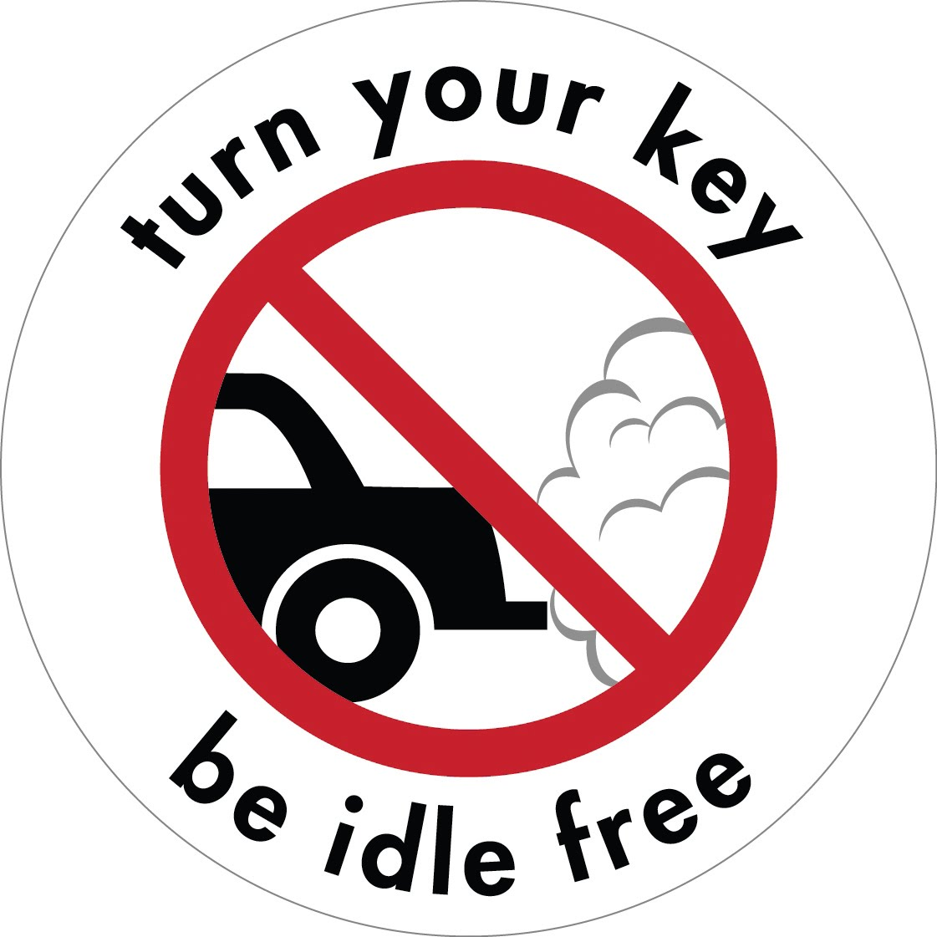
Every Child Should Breathe Clean Air.

Slide 3
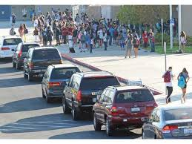
Children Need Clean Air Every day, children walk past cars that are on.
When a car is on when it is parked, the car is idling.
There are many cars idling in parking lots, school zones, parks and other places children go.

Slide 4
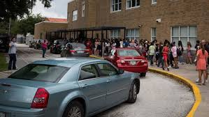
Most cars idle 16 minutes a day.
Idling is leaving the car on while parked.
School zones and parking lots are full of cars idling.

Slide 5
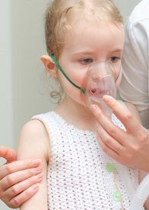
Idling Cars Cause Air Pollution
Air pollution damages the
eyes
nose
throat
heart
lungs
and causes diseases and sickness

Slide 6
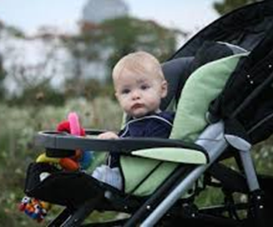
Air Pollution Can Permanently Damage
a Child’s Ability to Breathe
Children breathe 50 percent
more air per pound than adults.
Infants in strollers and children are the most at risk.

Slide 7
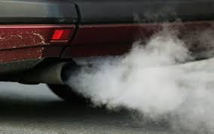
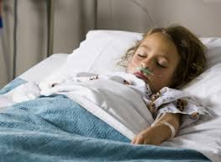
Car Exhaust Is Dangerous!
Stay Away From Cars!
carbon monoxide CO
formaldehyde CH2O
benzene C6H6
hydrocarbons CnH (2n+2)
nitrogen oxide NO
nitrogen dioxide NO2
sulphur dioxide SO2 VOC *PM (Particulate Matter)
Turn It Off! Please get well soon!
PM 1, PM 2.5, PM 10 are solid particles

Slide 8
The Carbon Monoxide in
1 minute of idling is 3 packs of cigarettes.
>

Slide 9
Idling Puts Dangerous, Toxic Chemicals
in the Air and Hurts Children’s Health
Asthma is the most common breathing problem
in children and causes the most school absences.
Breathing can be painful and difficult with
asthma, emphysema, COPD and lung diseases.

Slide 10
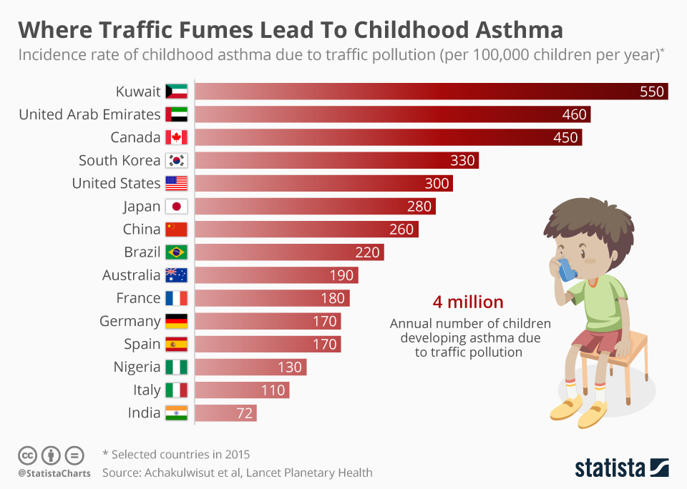
fumes.
About 4 million children develop asthma each year because they breathe polluted air.

Slide 11
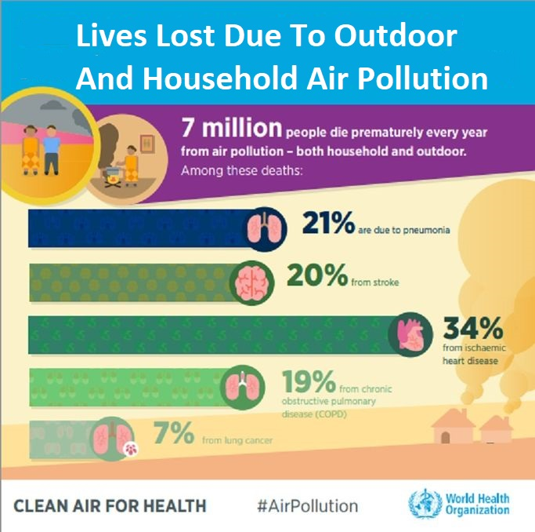
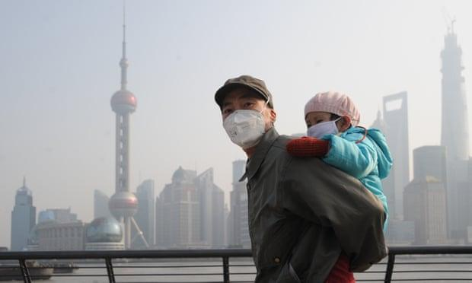
Air Pollution Is A Global Problem
2019 State of Global Air Report
Shortened life expectancy by 20 months on average by breathing toxic air.

Slide 12
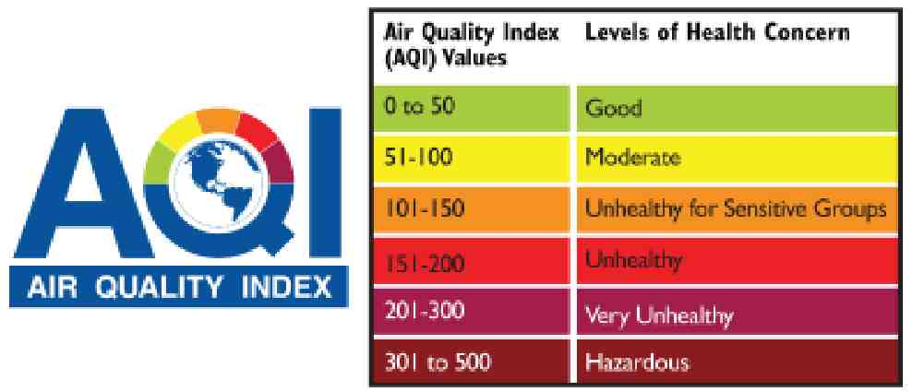
Idling Causes Air Pollution
Clean, Safe, Healthy, Good Air Does NOT Have Dangerous Chemicals or PMs (Particulate Matter)

Slide 13
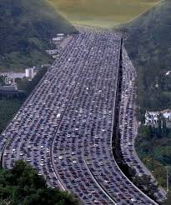
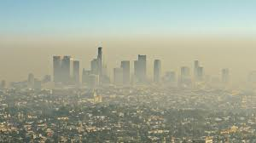
Eliminating idling cars in U.S. would remove as much pollution as taking 5 million vehicles off the roads.

Slide 14
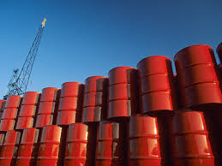
200,000 barrels of foreign oil
and 3.8 million gallons of fuel are burned every day in the
United States because of idling

Slide 15
Idling Produces CO2 and Climate Change
Burning 1 gallon of gas = 20 pounds of carbon dioxide
in the atmosphere.
CO2, carbon dioxide, is a greenhouse gas.
Greenhouse gases cause more and more heat over time.
27% of greenhouse gases, GHGs, in the U.S. are
are from transportation.

Slide 16
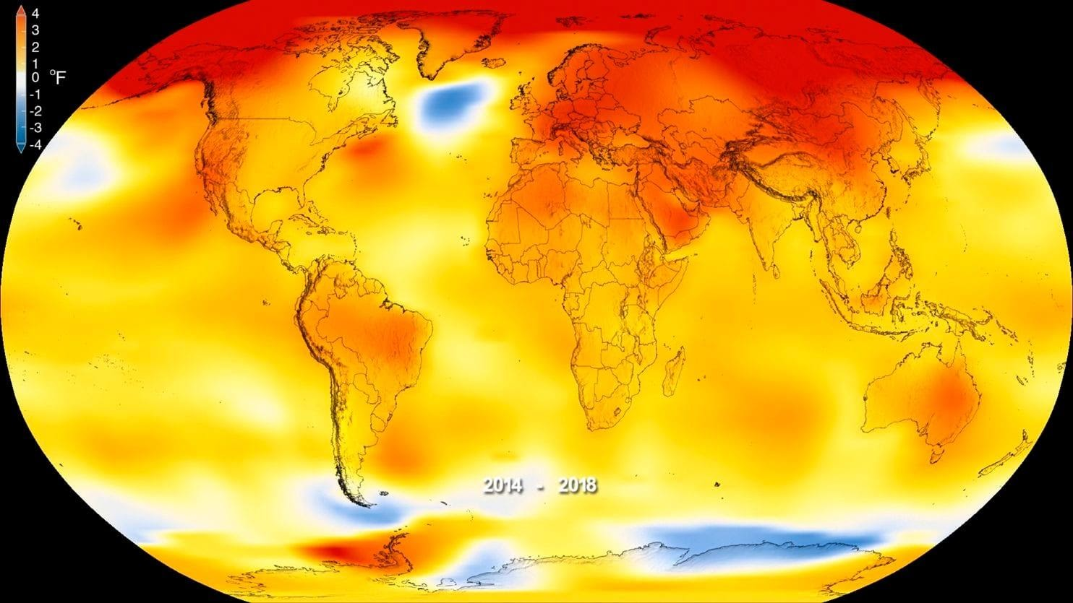
Each Year in the U.S. Idling Causes
30 million tons of CO2, carbon dioxide, to go into the air.
Every 100,000 idling drivers add 89,686 metric tons of CO2
into the air.
CO2 traps heat and contributes to
climate change and global warming.

Slide 17
Greenhouse Gases Get Trapped. They Get Hotter and Hotter.

Slide 18
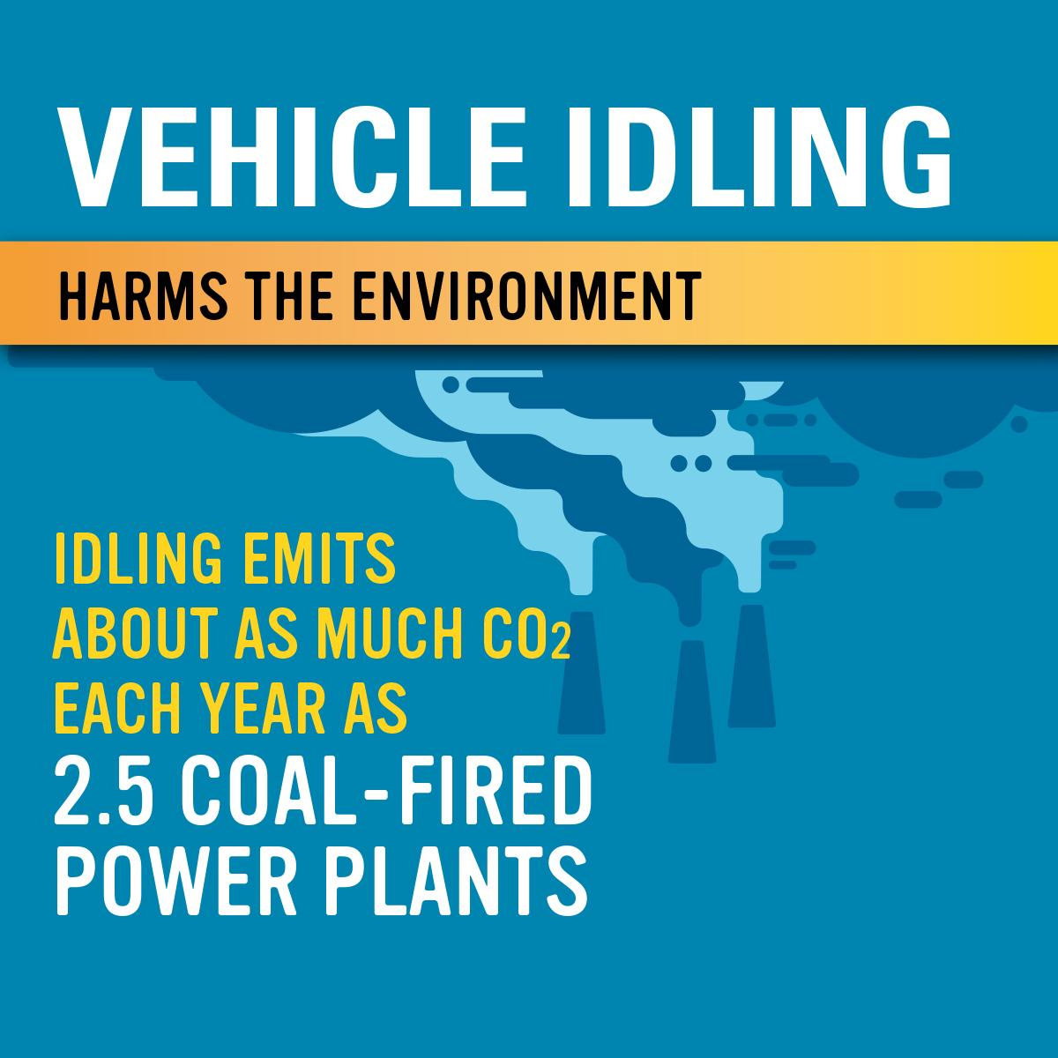

Slide 19
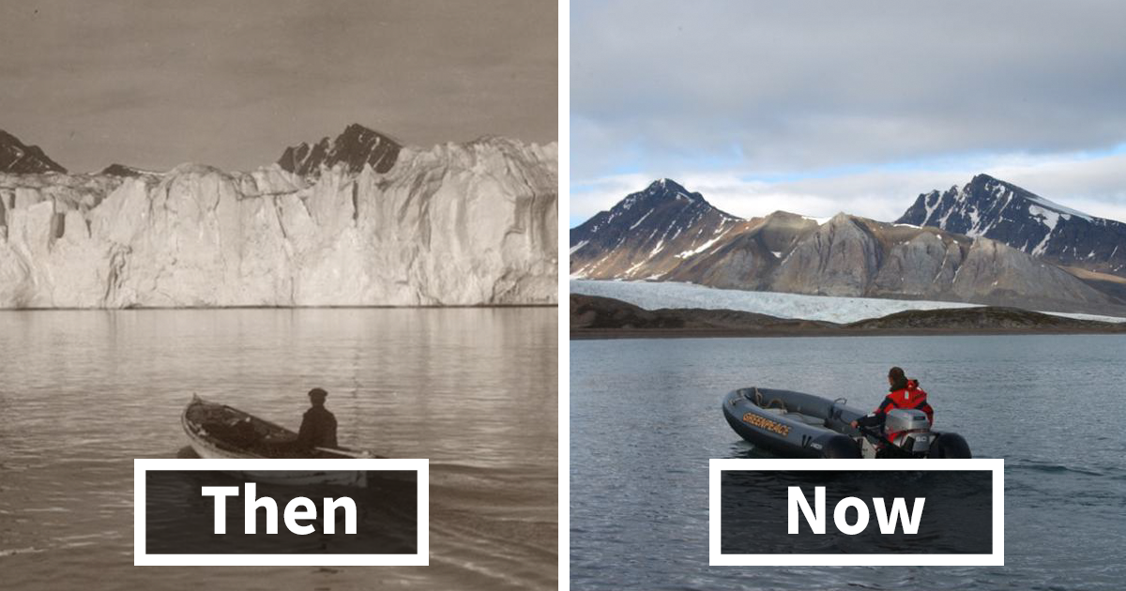
The Artic glaciers are melting.
The oceans are getting warmer over time.

Slide 20
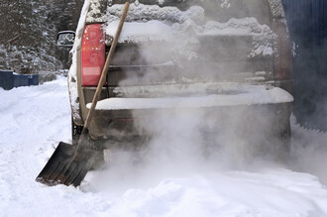
Let people know
Modern cars don’t need to idle.
Even on the coldest days, engines are ready in 30 seconds.
Engine idling increases vehicle maintenance costs.
Idling can shorten vehicle life.

Slide 21
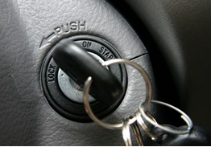
Pollution adds up. You can help.
Let people know it makes a difference if they turn OFF their car right after they park
and
wait to turn the engine ON until they are actually driving, not checking their phones.

Slide 22
What can I do?
Share the facts.
Post signs and hang posters.
Ask the school board and city council to restrict idling.
Start contests and challenges at your school, district, city and neighborhood or join ours.
Create and share your poster, multimedia presentation, song, poem, essays or news article. Contact the media.
Please enjoy our free curriculum. Create and share your ideas and lessons.

Slide 23
How To Make Change Happen
Contact Your:
School, School District, PTA, City Council and State Representative. 1. Call and setup a meeting. Present the information.
2. Attend a public meeting, fill out request to speak, speak during 3 minutes public comment session.
Ask for No Idling Agenda Item on the next meeting.
Ask for signs, pledge, education, policies, contests, challenges.
Ask for a No Idling Resolution (Proclamation or Declaration).

Slide 24
Steps To Help Your School Stop Idling
Step 1: Review and modify sample letters and policies.
Schedule No Idling training sessions with staff. Pass out Pledge Forms.
Step 2: Announce No Idling or Turn Your Key, Be Idle Free program.
Send letters to drivers and delivery workers. Start No Idling Pledge drive.
Step 3: Join our No Idling contests and challenges or create your own.
Step 4: Outside, install No Idling signs in strategic areas.
Step 5: Inside, hang posters and hand out free No Idling window decals.

Slide 25
Team 3: No Idling Resource Packet
8. Sign Logos Turn Your Key, Be Idle Free- round logo for stickers, signs, documents, etc.
9. No Idling Resolution Example for schools, school boards, districts, cities. Oceanside Unified School District No Idling Resolution Example Vista Unified School District No Idling Resolution Example
*Also see Safe Routes for Schools Program
10. State Resolution- No Idling, California ACR- 160
11. School Procedures Templates. Getting Started Template
12. 6 Reasons Why School Districts Should Pass No Idling Resolutions Essay
1. PowerPoint Presentations. No Idling Vehicle exhaust is toxic. No Idling. Please turn off your engine when parked to protect children’s health, public safety, air, water and non-toxic lands.
2. Contests and Challenges
3. Pledge Forms and Handouts Turn Engines Off Until It is Time To Drive
4. Letters to Parents Sample No Idling Policies
5. Letters to Delivery Drivers No Idling Policy
6. Newsletters, Website Announcements No Idling
7. Signs. Costs, Spreadsheet Examples. *See Sign Design Contest and Sign Posting Challenges
Social Justice is Environmental Justice

Slide 26
Thank you for protecting children, clean air, water and non-toxic land.
Engines off until it’s time to drive.

Slide 27
References
US Dept of Energy
IdleBox Toolkit for Idling Reduction Projects - https://cleancities.energy.gov/technical-assistance/idlebox
Idle Reduction Benefits and Considerations - https://afdc.energy.gov/conserve/idle_reduction_benefits.html
Idle Reduction - https://afdc.energy.gov/conserve/idle_reduction_basics.html
Summary of OEM Idling Recommendations From Vehicle Owner’s Manuals - https://info.ornl.gov/sites/publications/files/Pub61263.pdf
US Dept of Transportation
2016 Motor Fuel Use - https://www.fhwa.dot.gov/policyinformation/statistics/2016/mf21.cfm
US Environmental Protection Agency
Idle-Free Schools Toolkit for a Healthy School Environment - https://www.epa.gov/schools/idle-free-schools-toolkit-healthy-school-environment
Clean School Bus Idle Reduction - https://www.epa.gov/cleandiesel/clean-school-bus-idle-reduction
Fast Facts on Transportation Greenhouse Gas Emissions - https://www.epa.gov/greenvehicles/fast-facts-transportation-greenhouse-gas-emissions
California Air Resource Board
California Greenhouse Gas Emission Inventory - https://www.arb.ca.gov/cc/inventory/data/data.htm
Argonne National Laboratory
Idle Reduction Information - https://www.anl.gov/es/idle-reduction-information
Reducing Vehicle Idling - https://www.anl.gov/es/reducing-vehicle-idling
Idle Reduction Research - https://www.anl.gov/es/idle-reduction-research

Slide 28
References Continued
University of Vermont Transportation Research Center
Passenger Vehicle Idling in Vermont - https://info.ornl.gov/sites/publications/files/Pub61263.pdf
National Conference of State Legislatures
Putting the Brakes in Idling Vehicles - http://www.ncsl.org/research/environment-and-natural-resources/putting-the-brakes-on-idling-vehicles.aspx
Maryland Department of the Environment
Idle Free Maryland - https://mde.maryland.gov/programs/Air/MobileSources/idlefreeMD
Ohio State University
Air pollution linked to learning and memory problems, depression - https://www.sciencedaily.com/releases/2011/07/110705071735.htm
Vanderbilt University
Costly myths: An analysis of idling beliefs and behavior in personal motor vehicles - https://www.sciencedirect.com/science/article/pii/S0301421509001633
National Center for Biotechnology Information
Exposure to diesel and gasoline engine emissions and the risk of lung cancer - https://www.ncbi.nlm.nih.gov/pubmed/17062632
Sustainable America
Turn It Off - https://iturnitoff.com

